Slide 1
BIG idea:
What is propaganda—its role; its influence?

Slide 2
What is Propaganda?
I. Heavily debated!
II. Propaganda is:
biased information designed to shape public opinion and behavior
Notes:
What connections do you have to bias in your everyday life?

Slide 3
HISTORY
I. Latin derivative
Propagation: reproduction of plants and/or animals
II. 17th Century: new meaning
Catholic Church Papacy—the “Sacred Congregation of the Propagation of Faith”
Battle Protestantism with Catholicism
Shape opinions and behaviors
Notes:
What influence did this “propagation of faith” have on the rest of the world? Give me examples of the opinions and behaviors it helped to shape.

Slide 4
HISTORY
III. 18th and 19th Century
More prominence—political realm
Tool for social control
Replaced strict censorship
Government “news”
Notes:
How do you feel about a government forcing an opinion on its people?

Slide 5
HISTORY
IV. WWI and WWII
Surge!
All world powers employed writers, artists, and filmmakers to create methods of mobilization
Lies, manipulation, and falsehood
Slaves of the government
Marketplace of ideas
“Propaganda is a truly terrible weapon in the hands of the expert.”
-Adolf Hitler

Slide 6
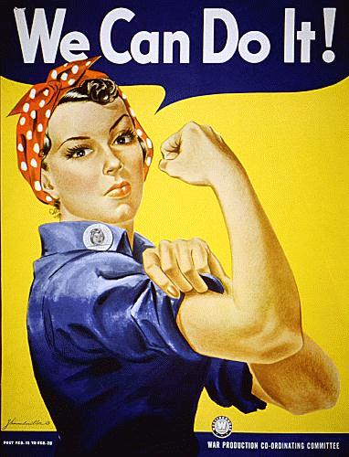
Notes:
Can anyone tell me what the meaning behind these posters? What kind of thoughts and feelings are evoked from these campaigns?

Slide 7
So, what does Propaganda look like?
I. 5 basic components
Simplifies complicated issues or ideologies
Is always biased
Is geared toward achieving a particular goal
Uses symbols:
Music
Written
Visual
Plays upon human emotion

Slide 8
WWII Disney Cartoon
http://www.youtube.com/watch?v=oqMVpcbhpqw

Slide 9
Propaganda Today
I. Common Uses:
Advertising
Education—Government sponsored
http://www.youtube.com/watch?v=5zWB4dLYChM&feature=BFa&list=PLN5SDJrIJQSFYBDuf5e9xxo6go47wMnKJ
Political Ads
Obama: http://www.youtube.com/watch?v=iys1BWUf-Nc&feature=BFa&list=PLN5SDJrIJQSFYBDuf5e9xxo6go47wMnKJ
Romney: http://www.youtube.com/watch?v=Nj70XqOxptU&feature=BFa&list=PLN5SDJrIJQSFYBDuf5e9xxo6go47wMnKJ
Notes:
What sort of impact do Anti-Smoking campaigns have on the economy? Is this the kind of message a government should support?

Slide 10
One Last Thought
Entertainment
http://www.youtube.com/watch?v=tl9aqZk4kFU&feature=autoplay&list=PLN5SDJrIJQSFYBDuf5e9xxo6go47wMnKJ&playnext=1

