Slide 1
The Usa Patriot Act
Preserving Life and Liberty

Slide 2
YouTube
Fox News Interview
http://www.youtube.com/watch?v=9QRt_XJJ3XY&feature=related
Mitt Romney
http://www.youtube.com/watch?v=EjaXfwuGmxg&feature=related
Debate (Ron Paul vs. Newt Gingrich)
http://www.youtube.com/watch?v=OBSqtGX-alc

Slide 3
Timothy Mcveigh

Slide 4
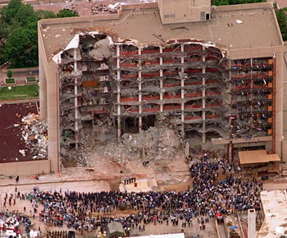
Oklahoma City Bombing
April 19, 1995
168 People Killed
Over 800 People Injured
Alfred P. Murrah Federal Building

Slide 5
Department of Justice
Primary responsibility:
Prevent future terrorist attacks
Congress
The USA PATRIOT Act
Modifications to old laws—new tools
Bipartisan support

Slide 6
What does name stand for?
The
Uniting and
Strengthening
America by
Providing
Appropriate
Tools
Required to
Intercept and
Obstruct
Terrorism
Act: Preserving Life and Liberty

Slide 7
The Claim:
“The Act improves our counter-terrorism efforts in several significant ways.”
Outlines FOUR major points

Slide 8
ONE
“The Patriot Act allows investigators to use the tools that were already available to investigate organized crime and drug trafficking.”
Roving Wiretaps

Slide 9
TWO
“The Patriot Act facilitated information sharing and cooperation among government agencies so that they could better ‘connect the dots.’”
Police officers, FBI agents, federal prosecutors, and intelligence officials

Slide 10
THREE
“The Patriot Act updated the law to reflect new technologies and new threats.”
Computer hackers

Slide 11
FOUR
“The Patriot Act increased the penalties for those who commit terrorist crimes.”
Harboring of terrorists
Inadequate penalties

