Slide 1
The Bill of Rights

Slide 2
What is the Bill of Rights?
First 10 Amendments of the Constitution
There are 27 Amendments in all but only the first 10 are called the Bill of Rights
Protects basic rights of American citizens

Slide 3
1st Amendment
Freedom of RAPPS
R – Religion
A – Assembly
P – Press
P – Petition
S - Speech

Slide 4
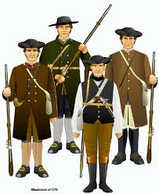
2nd Amendment
Freedom to bear and keep arms

Slide 5
3rd Amendment
Americans cannot be forced to house or feed soldiers

Slide 6
4th Amendment
Freedom from unreasonable search and seizures
Before authorities can search someone’s property they must first have a search warrant
Search warrant – an order permitting the authorities to look through someone’s property

Slide 7
5th Amendment
Right to due process of law, freedom from self-incrimination, and double jeopardy
Due process – fair application of the law
Self-incrimination – being forced to testify against yourself
Double jeopardy – can’t be tried for the same crime twice

Slide 8
6th Amendment
Right to a speedy and public trial by jury
The accused person has a right to know the charges against them
The accused person can hear and question witnesses
The accused person has the right to an attorney (if they can’t afford one, the government provides one)

Slide 9
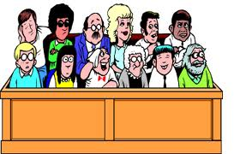
7th Amendment
Right to a trial by jury in civil cases

Slide 10
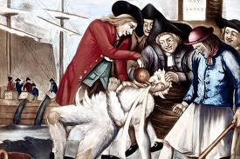
8th Amendment
No cruel and unusual punishment
Bail must fit the crime
Bail - the money that defendants promise to pay the court if they do not appear in court at the proper time.

Slide 11
9th Amendment
The rights listed on the Constitution are not the only rights citizens have
This allows Congress and courts to recognize other basic rights of citizens
Example: Everyone has the right to education

Slide 12
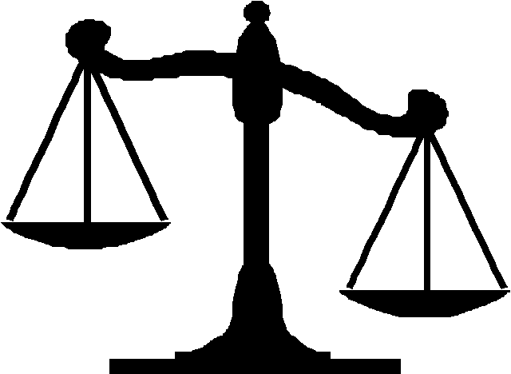
10th Amendment
State governments can make laws regarding the things not covered in the Constitution.
Keeps balance between Federal and State governments

